Slide 1

1 / 21
Final Project Evaluation: PRF193
MINI-SUPERMARKET MANAGEMENT
An Advanced C++ Object-Oriented Application
IC21A03
Group 6

Slide 2


2 / 21
1. Project Repository (GitHub)
Open Source Transparency
To ensure a transparent and professional development process, our entire codebase is tracked securely via Git.
Scan the QR Code You can use your phone to scan the QR code on the right to access our GitHub Repository directly.

Slide 3





3/ 21
2. Group Introduction
Nguyễn Ngọc Nam (Leader)
Student ID: DE200201
Nguyễn Hải Dương
Student ID: DE200154
Nguyễn Đỗ Tiến Thịnh
Student ID: DE200232
Lê Nhật Thành
Student ID: DE200496

Slide 4

4 / 21
3. Project Objectives
Academic & Practical Goals
To design a highly optimized, memory-safe console application that handles real-world business requirements.
Apply OOP Principles Encapsulation, Abstraction, Inheritance, and Polymorphism.
Advanced Algorithms Implement O(log n) complexity search methods.
Data Persistence Read and write states securely using .

Slide 5


5 / 21
4. Problem Statement
The Traditional Retail Issue
Our Digital Solution
Many small-scale stores rely on manual inventory tracking. This presents significant flaws:
We developed a C++ application that digitizes the entire workflow:
▪
High risk of data loss upon power failure.
▪
Persistent data structures (`products.txt`).
▪
Slow order processing and checkout times.
▪
Automated Order Approval Workflow for Staff.
▪
Lack of accountability (No record of who modified the stock).
▪
Integrated Audit Logs to track every employee action.

Slide 6
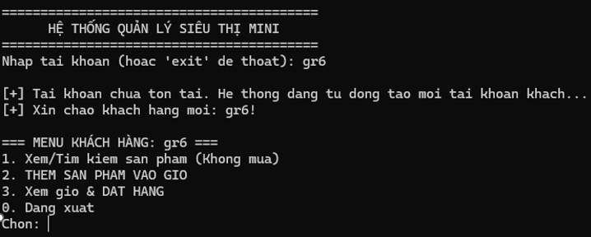
6 / 21
5. Software Introduction
Mini-Supermarket Environment
The system simulates a fully functional Retail Store. It handles practical data such as Item IDs, Categories, Pricing (VND), and Stock Levels.
Multi-Actor Roles: Supports interaction from Customers, Staff, Managers, and the Boss.
Notification System: A built-in inbox that alerts users about order statuses.
Smart Guest Login: Auto-creates customer accounts for unregistered visitors.

Slide 7

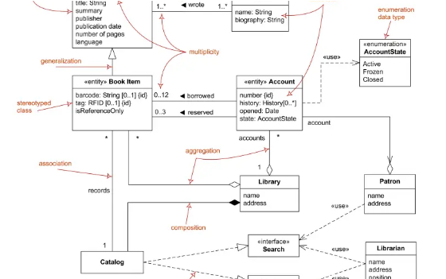
7 / 21
6. Core System Architecture (UML)
Entity Relationship Model
The source code is categorized into three primary OOP groups:
Data Models: Product class, CartItem & Order structs.
Human Actors: The User base class and its 4 polymorphic derived classes.
The Engine: The Store class acts as the central Database & Controller.

Slide 8
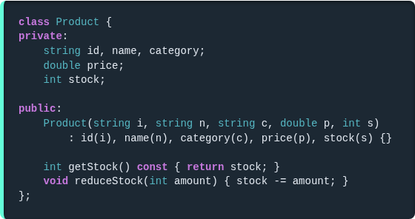
8 / 21
7. OOP: Encapsulation
Data Hiding & Protection
Sensitive attributes within the Product class are strictly marked as private.
Inventory modifications cannot be assigned directly. They must pass through the reduceStock() method, ensuring stock logic is executed safely.

Slide 9
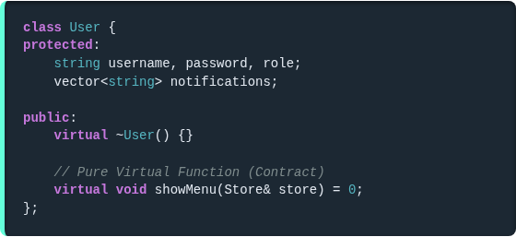
9 / 21
8. OOP: Abstraction
The Abstract Base Class
The User class serves as an abstract blueprint. Credentials are shielded behind the protected modifier.
The pure virtual function showMenu() = 0 establishes a strict contract: every derived role must implement its own specific user interface.

Slide 10
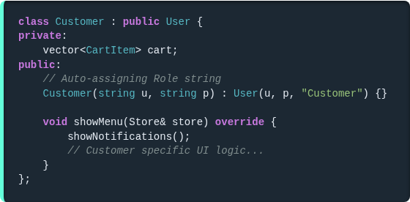
10 / 21
9. OOP: Inheritance (Part 1)
Polymorphic Derivation
The Customer and Staff classes publicly inherit from User.
This eliminates code duplication for credential management. Each subclass automatically hardcodes its role string into the parent's constructor during instantiation.

Slide 11
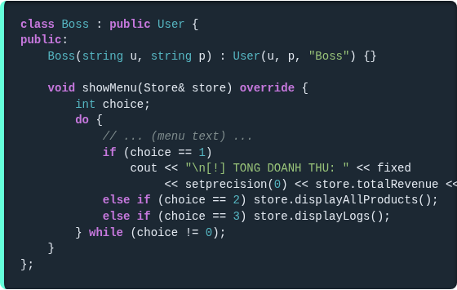
11 / 21
10. OOP: Inheritance (Part 2)
Administrative Privileges
Similarly, the Manager and Boss classes inherit the exact same core framework.
However, by overriding the showMenu() function differently, they gain exclusive capabilities to interact with the Store object's restricted variables, such as viewing total revenue.

Slide 12
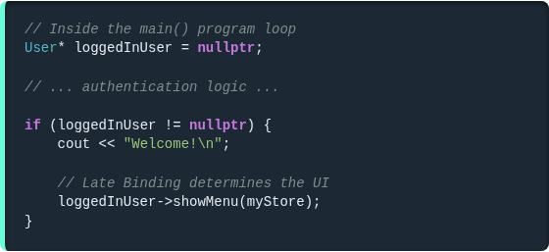
12 / 21
11. OOP: Polymorphism
Late Binding (Dynamic Routing)
This is the crown jewel of our architecture. In the main loop, we execute a single, generic command: loggedInUser->showMenu().
C++ dynamically determines the exact object type in memory at runtime and flawlessly renders the correct UI without requiring complex switch statements.

Slide 13
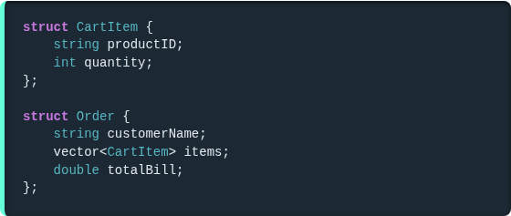
13 / 21
12. Data Decoupling (Cart System)
Safe Struct Referencing
Instead of storing raw `Product*` pointers which can become dangling if a product is deleted, we decouple the data using string productID.
The Order struct cleanly encapsulates the Customer's name, the Vector of CartItems, and the Total Bill, making it ready to be pushed to the pending queue.

Slide 14
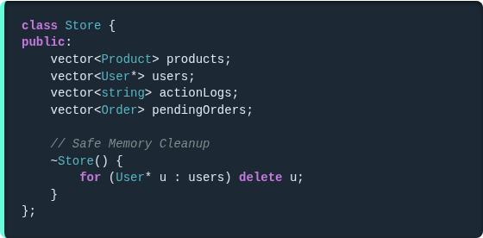
14 / 21
13. STL: Vectors as Databases
Dynamic Memory Allocation
The Store class replaces static C-arrays with std::vector containers to manage dynamic scaling securely.
The products and users act as our core DB.
The destructor safely uses a loop to delete User pointers, preventing memory leaks upon system shutdown.

Slide 15
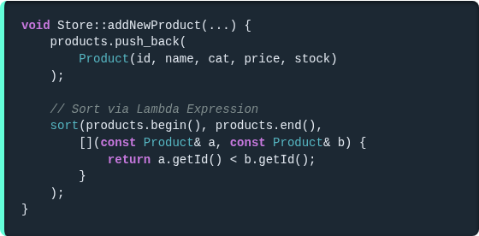
15 / 21
14. STL Algorithms: Sort & Lambdas
Automated Data Organization
Whenever a Manager adds a new product or imports data from a file, the system immediately invokes std::sort.
Combined with an inline Lambda Expression, it guarantees the inventory is always sorted alphabetically by ID, which is a critical prerequisite for Binary Search.

Slide 16
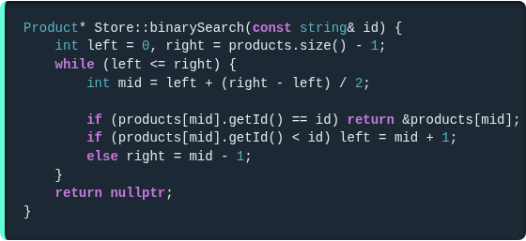
16 / 21
15. Advanced Algorithms: Binary Search
O(log n) Efficiency
For operations requiring exact ID lookups (like verifying Cart IDs), standard for-loops are too slow for large datasets.
We implemented a custom Binary Search that divides the sorted vector repeatedly, achieving massive performance gains.

Slide 17
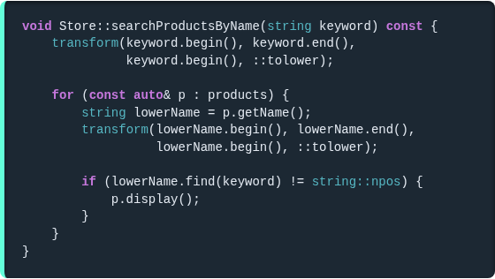
17 / 21
16. Advanced String Manipulation
Case-Insensitive Substrings
Rather than relying on strict equivalence (==) which frustrates users, we engineered an advanced search.
By using std::transform with ::tolower, we convert queries to lowercase. Then, string::find with string::npos easily matches partial inputs (e.g., "beef" finds "Thit Bo").

Slide 18
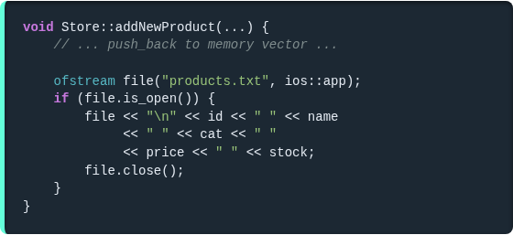
18 / 21
17. Robust File I/O
Data Persistence
The system utilizes to permanently store database operations.
ifstream loads data from products.txt during system boot.
ofstream with ios::app safely appends newly created products to the file without overwriting existing data.

Slide 19
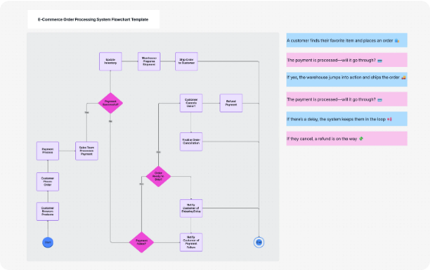
19 / 21
18. Order Approval Workflow
Bridging Customer & Staff
When a Customer checkouts, the transaction is not finalized immediately. It enters the pendingOrders vector.
The Staff member must access Menu Option 2 to review the order. The system loops through the CartItems, re-verifying the inventory via Binary Search before allowing the Staff to approve (deducting stock) or cancel.

Slide 20
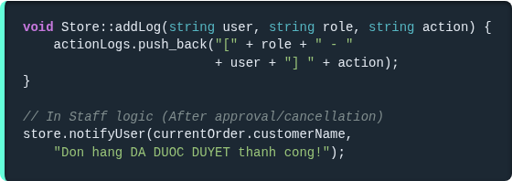
20 / 21
19. Notifications & Audit Logs
Security & UX Integration
Audit Logs: Whenever a Manager imports products or Staff approves an order, addLog() captures the Action. Monitored exclusively by the Boss.
Notifications: The notifyUser() method pushes a message to the specific Customer, alerting them immediately about order statuses.

Slide 21

21 / 21
Live Demo & Q&A
Transitioning to the Console to execute the live software.
Thank you !

